Slide 1
Data Flow Modelling
Concepts
Data Flow Diagrams
I/O Descriptions
External Entities, Data Stores, Processes and Data Flows
The Context Diagram
Elementary Process Descriptions
Levelling
Drop Through
Document Flow Diagrams

Slide 2
Data Flow Modelling
Modelling a system’s processes
Data Flow Modelling is a widely used and mature analysis technique, and is recommended by most structured methods
Data Flow Models (DFMs) are easy to understand and, with a little practice, reasonably quick and straightforward to develop
They consist of two parts: a set of Data Flow Diagrams (DFDs) and a set of associated textual descriptions
… that provide us with the truly effective tool for understanding the information processes of a system

Slide 3
Data Flow Modelling
The Business Activity Model indicates the human activities that take place in the environment that concern us, but does not contain enough detail yet to build a computerised information system.
The technique of Data Flow Modelling is used to progress the analysis of the system’s processes by providing a more detailed model of all the system’s data processes.

Slide 4
Data Flow Diagrams
A communication aid
Before we see how to produce a DFD we will show how a DFD can be used to communicate with users (who are not expected to understand how to produce one)
Imagine you work in a small stock control environment where goods are bought and sold
There are two job descriptions in our imaginary system: stock clerks and cashiers
Stock Clerks ‘order’ and ‘receive’ goods
Cashiers ‘sell’ goods
An analyst has observed you and come up with the following diagram…

Slide 5
Data Flow Diagrams aid communication
e
Manager
Purchase Order
External Entities
1 Stock Clerk
Stock List
Order
Stock List
M2
Stock
P.O.
Stock
File
d
Processes
Data Stores
Supplier
Purchase Order
Delivery
2 Stock Clerk
Receive
Orders
M1
Purchase Order
Stock
Cabinet
Matched Orders
*
e
Manager
Delivered Goods
3 Cashier
Sell
Sold Goods
M2
Stock
Stock
File
*
a
Bought Goods
Customer

Slide 6
Data Flow Diagrams
The Data Flow Diagram (DFD) is the visible part of the Data Flow Modelling (DFM) technique
If used, the DFD is drawn at the very beginning of the analysis where, in various guises, it helps define the context of the system under consideration
It then becomes, with the LDS, the main place for recording the analysts’ understanding of how the current system functions

Slide 7
Data Flow Diagrams
When a good understanding of the data movements of the current system has been achieved, the logic of the system is distilled from the DFD and a new ‘logical’ DFD may be produced
This DFD contains the essence of the system’s functionality, free from technical and physical constraints that may exist in the current system
With the logical view of the system in hand, the analysts propose alternative options for a new system
The users choose one of these options and a final DFD is drawn for the, by now, ‘required’ system

Slide 8
Data Flow Diagrams
DFD Notation
The DFD is a diagram that consists principally of four symbols, namely the external entity, the data flow, the process and the data store
Additionally, a physical flow can be shown on the DFD of the current system

Slide 9
Data Flow Diagrams
External Entities
d
Supplier

Slide 10

Data Flow Diagrams
Data Flows
Data Flow (usual)
Bi-directional Flow (rare)
Flow Between External Entities (for convenience)
Resource Flow (for convenience)
Customer Details
Goods
Cosmetics

Slide 11
Data Flow Diagrams
Process
3
Cashier
Sell
Stock

Slide 12
Data Flow Diagrams
Data Stores
Digitised
Manual
Transient
Duplicate
D3 Suppliers
Stock
M1
File
T1 Unpaid Invoices
D1 Orders
D1 Orders

Slide 13
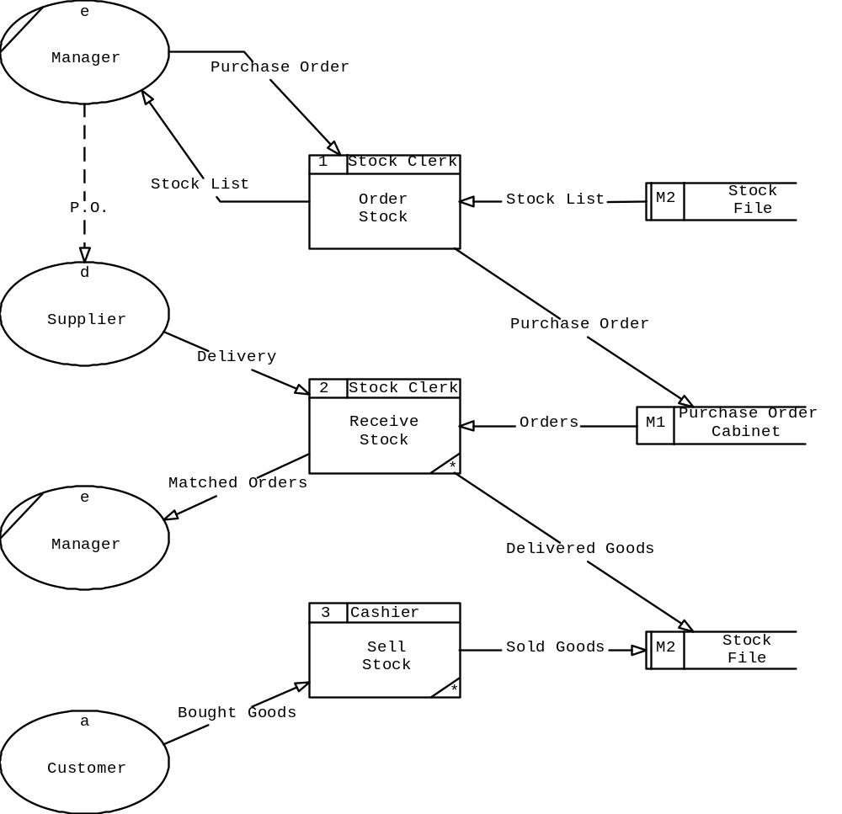
Data Flow Diagrams
Decomposition
Notes:
Note that what information actually moves about is not clear from the diagram alone. The diagram will only really become useful, in software engineering terms, when the data content of each data flow is identified
For example:
What is the content of the Purchase Order data flow emanating from Manager towards Order Stock?
Is it the product name and the quantity ordered?
Is the supplier name and address included?
Or is there just a supplier number that distinguishes one supplier from another?
Is the price of the product included in the flow?
If it is, which price is it?
The one from a price list?
The one the manager may have just negotiated with the supplier before setting up the purchase order?
Or is it the highest price the manager expects to pay?
Also, is the order date included in the flow?
Is there a date indicating the latest date beyond which the goods will not be accepted?
Are there any other conditions attached to the order, such as a request not to deliver it in parts?
Only after careful investigation can the analyst answer these questions and draw an effective diagram.
In the case of the Small Stock Control system we are considering for the moment, the obvious place to look for answers to the above questions is a sample of an actual Purchase Order used by the business.
Request a copy of one and read off the data items it contains.
Then check with the users whether they want any additional information to be included.
Specifically enquire whether the information on the existing Purchase Order is sufficient to allow a hassle-free match with the supplier’s delivery note which will accompany the stock when it arrives.
Asking these questions in order to fill-in the data content of each data flow enhances the analysts’ understanding of the situation and facilitates the task of providing a computer information system that actually supports the business.

Slide 14
Data Flow Diagrams
Decomposing Data Flow Diagrams
A closer look at process 1 of the Small Stock System also shows that it is logically consistent and does indeed describe the activity of ordering stock
On the other hand, it does not contain enough detail to understand exactly what happens when stock is ordered
For example:

Slide 15
Data Flow Diagrams
Decomposing Data Flow Diagrams
Is there any time lapse between the production of a stock list and a firm order coming back?
When does a check of the product files take place?
Who is responsible for choosing which supplier to use?
The DFD deals with these issues by allowing more detailed views of the high level processes
This is done by breaking up each process into as many sub-processes as deemed necessary

Slide 16
Data Flow Diagrams
Decomposing Data Flow Diagrams
Any process on a DFD may be broken up into several sub-processes which, when viewed collectively, make up that process
Thus for example we may break-up process 1 of the Small Stock System into that shown on the next slide:

Slide 17
Data Flow Diagrams
Decomposing Data Flow Diagrams
e
Manager
1 Order Stock
Stock List
Purchase Order
1.1
1.2
Produce
Record
Stock
Purchase
List
*
Order
*
Stock List
Purchase Order
M2
Stock
M1
Purchase Order
File
Cabinet

Slide 18
Data Flow Diagrams
Decomposing Data Flow Diagrams
The decomposition of a DFD into lower level DFDs is known as levelling
The DFD that shows the entire system is known as the ‘top level’ or ‘level 1’ DFD
The DFDs that contain more detailed views of the level 1 processes make up ‘level 2’ DFDs
Any level 2 process that is further decomposed gives rise to a level 3 DFD and so on

Slide 19
Data Flow Diagrams
Decomposing Data Flow Diagrams
A process that is decomposed is known as a ‘parent’ whose ‘children’ are the diagrams derived from it
Any process that does not contain any further decomposition ( i.e. has no children) is known as a ‘bottom level’ or ‘elementary’ process
These elementary processes constitute the building blocks of the system and as such need to be considered carefully

Slide 20
Data Flow Diagrams
Decomposing Data Flow Diagrams
They will contain enough detail for a program specification to be deducible from them at a later stage
As such, a clear description of each one has to be produced at some time during the analysis
These Elementary Process Descriptions (EPDs) are written in plain English, or in pseudocode, depending on the project team. A sample EPD follows:

Slide 21
Data Flow Diagrams
Decomposing Data Flow Diagrams
Elementary Process Description
System: Small Stock DFD Type: Current
Process Name: Record Purchase Order Process Id: 1.2
Managers give the stock clerk a ready-made purchase order. The stock clerk places this order in the Purchase Order Cabinet.
It is the managers’ responsibility to send the order directly to the supplier they have chosen. Each purchase order contains product information taken from the supplier’s price list. The date after which a delivery of goods will be unacceptable is also included.

Slide 22
Data Flow Diagrams
Decomposing Data Flow Diagrams
1.2
Record
Purchase
Order
*

Slide 23
Data Flow Diagrams
Decomposing Data Flow Diagrams
If there is a flow on a level 2 diagram that does not correspond to one on its parent diagram then something is wrong
In this case either the top level or the lower level diagram needs updating, depending on further analysis

Slide 24
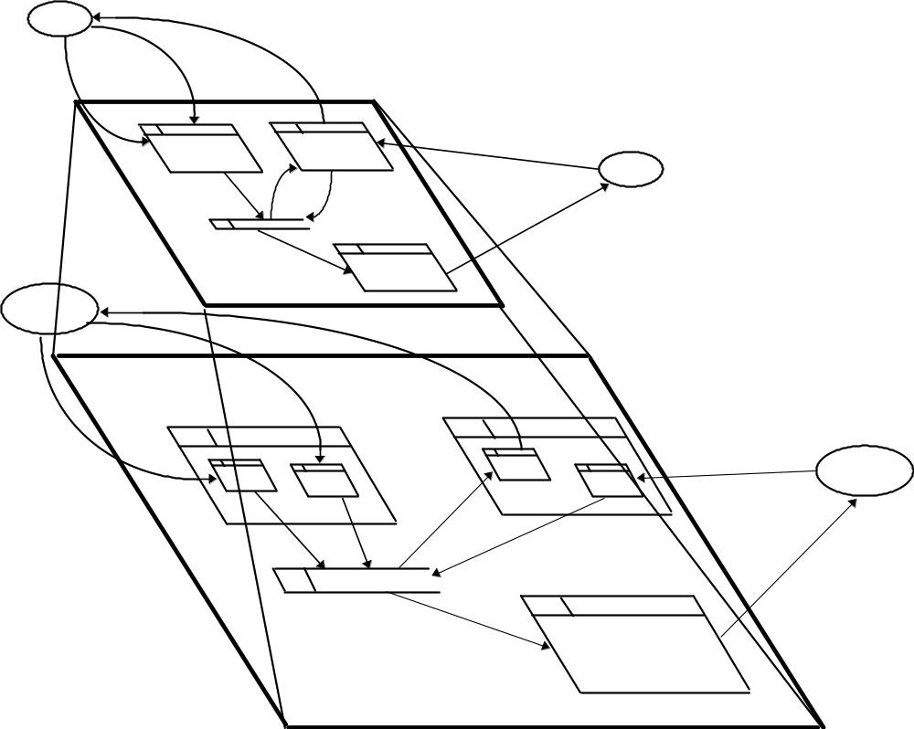
Data Flow Diagrams
Decomposing Data Flow Diagrams

Slide 25
Data Flow Diagrams
Context Diagrams
A level higher than level 1, showing the whole system as a single process with external entities around it, is also possible:
e
Manager
P.O.
Stock List
Purchase Order
Matched Orders
d
Small
Stock
Delivery
Supplier
System
Bought Goods
a
Customer

Slide 26
Data Flow Diagrams
Context Diagrams
All the DFD rules apply here
All the incoming and outgoing flows to and from the context diagram should correspond directly with the flows seen flowing between all level 1 processes and the external entities they interact with
Further, since each lower level DFD is consistent with its parent diagram, it will be possible to trace each flow seen in the context diagram down to the elementary process that either generates that flow or receives it

Slide 27
Data Flow Diagrams
I/O Descriptions
The flows shown on the Context Diagram are of vital importance since it is for these interactions with the outside world that the system exists and through which it will be judged as a good or a bad system
For this reason we ensure we are 100% confident with the content of each input to or output from the system by necessitating the completion of a document that traces each external flow down to an elementary process
This document is called an I/O Description:

Slide 28
Data Flow Diagrams
Context Diagrams
Data Flow | Data Item | Remarks
Stock List | product name quantity in stock
Purchase Order | supplier name supplier address supplier’s product code product name quantity ordered purchase order date latest acceptable delivery date | Purchase order contains one ‘supplier name’ but many ‘product name’

Slide 29
Data Flow Diagrams
Developing the processing view of the system
As with many systems analysis products there is no fixed way of producing a model (if indeed we decide to produce the said model in the first place!)
In the next few slides we will illustrate how some of our products can be used as precursors to Data Flow Modelling
Earlier in the series we met Business Activity Models and Resource Flow Diagrams
Today we are getting a feel for Data Flow Diagrams, including Context Diagrams
In what follows we will also introduce Document Flow Diagrams

Slide 30
Data Flow Diagrams
Development – Drop Through
Either of these can be used as a starting point for modelling a system’s processing
We will use the ZigZag case study to show how we can move from one product to the other
If at any point of systems analysis you realise that you have produced something that is not used further in the analysis you should pause for thought…
…and question the prudence of developing the product in the first place
Each systems analysis product builds on the understanding contained in all its predecessors
The link between successive products is called drop through

Slide 31
Data Flow Diagrams
Starting from the Context Diagram
To develop a Context Diagram we carry out the following tasks:
(i) Identify all sources and recipients of data from the system, i.e. external entities
(ii) Identify the major data flows to and from the external entities
(iii)Convert each source or recipient into an external entity symbol
(iv)Add the data flows between each external entity and a single box representing the entire system

Slide 32
Data Flow Diagrams
Starting from the Context Diagram
External Entity S or R Data Flow
Supplier s Delivery Note
r Purchase Order
s Delivery Details
s Invoice
Purchaser s P.O. Quantities
r Stock Report
Customer r Dispatch Note
Sales & Marketing s Customer Order
r Matched C.O. #1
Accounts r Matched Invoices

Slide 33
Data Flow Diagrams
Starting from the Context Diagram
a
Supplier
Payment
Delivery Note
Purchase Order
Delivery
Invoice
Details
e
d
ZigZag
Accounts
Matched Invoice
Warehouse
Despatch Note
Customer
System
Stock Report
Matched C.O.
Customer Order
Copy #1
P.O.Quantities
b
Customer Order
c
Purchaser
Sales and
Marketing

Slide 34
Data Flow Diagrams
Starting from the Context Diagram
We can now follow each flow into and identify the elementary process responsible for it
A grouping of these elementary processes can then give us a first glimpse of the system’s Data Flow Model

Slide 35
Document Flow Diagrams
Document Flow Diagrams illustrate the flow of physical documents associated with the area under investigation
In this context, documents may take the form of pieces of paper, conversations (usually over the telephone) or even data passed between computer systems
To create a Document Flow Diagram we carry out the following tasks:

Slide 36
Document Flow Diagrams
Identify all recipients and sources of documents, whether inside or outside the system boundary
Identify the documents that connect them
Convert each source and recipient into an external entity symbol
Add data flow arrows to represent each connecting document
Add the system boundary to exclude the external entities identified in the context diagram

Slide 37
Document Flow Diagrams
Source Document Recipient
Supplier Invoice P.O.Clerk
Supplier Delivery Times Stock Clerk
Stock Clerk Stock Report Purchaser
Stock Clerk Stock Report Despatch Supervisor
Despatch Clerk Despatch Note Customer
Customer Customer Order Sales & Marketing
Sales & Marketing Customer Order Despatch Clerk
Despatch Clerk Despatch Report Despatch Supervisor
Despatch Super. Matched Dsp Rep Despatch Clerk
Despatch Clerk Matched CO #1 Sales & Marketing
….

Slide 38
Document Flow Diagrams
Despatch Supervisor
Sales and
Matched
Marketing
Despatch Rpt
Customer Order
Despatch Report
Matched C.O.
Copy #1
Despatch
Clerk

Slide 39
Data Flow Diagrams
Converting Document Flow Diagrams
To transform the Document Flow Diagram into a DFD we follow each document flow in turn, asking the following questions:
What process generates this document flow?
What process receives this document flow?
Is the document stored by a process?
Where is the document stored?
Is the document created from stored data?
What business activity triggers the process?
Is the document a source of new data?

Slide 40
Data Flow Diagrams
Converting Document Flow Diagrams
In the case of our example we soon note that two data stores are used, the ‘stock’ file and the ‘customer orders’ file.
We also quickly realise that ‘Sales and Marketing’ are clearly an external entity.
It takes some time to realise that the Despatch Supervisor constitutes an external entity who decides where to pick the customer’s stock from.
We are then left with the following two processes performed by the Despatch Clerk

Slide 41
Data Flow Diagrams
Converting Document Flow Diagrams
c
5
Despatch Clk
f
Sales and
Customer Order
Allocate
Despatch Report
Despatch
Marketing
Despatch
Supervisor
2 x C.O. Copies
Current Stock
Levels
Matched
M4
Customer
M2
Stock
Despatch Rpt
Orders
Matched
Despatch Rpt
Stock To
Customer Order
Be Used
Copy
6
Despatch Clk
c
Complete
Matched C.O.
Sales and
Customer
Copy #1
Marketing
Order

Slide 42
Data Flow Diagrams
Converting Resource Flow Diagrams
In an environment where a number of different physical resources move around frequently, it may be a good idea to start by modelling the flow of resources instead of the flow of documents.
With a resource flow in hand we can ask questions similar to those we asked when we were converting a Document Flow Diagram into a Data Flow Diagram, namely:

Slide 43
Data Flow Diagrams
Converting Resource Flow Diagrams
What process records the receipt of this resource?
What process records the placement of the resource in a resource store?
What process records the removal of the resource from a resource store?
What new or old data accompanies the resource?
What previously stored data is used in each movement of this resource?

Slide 44



Data Flow Diagrams
Converting Resource Flow Diagrams
Loading Bay
2 Goods Receiving
b
Supplier
Check
Delivery
Delivery Note
P.O. Copy
Purchase Orders
Matched P.O.
M1
T2
Matched P.O.’s
Matched P.O.
M2 Stock
New Stock
3 Stock Keeping
Store
Stock

Slide 45
Data Flow Diagrams
Converting Business Activity Models
If a BAM has been produced as part of modelling a system’s processing, and if the Project Team has also decided to produce a DFD, then this DFD should be based on the analysis that led to the BAM. Indeed it would be folly to ignore the BAM and to try and produce the DFD ‘from scratch’
A BAM is transformed into a DFD by asking of it questions such as:
  Does the activity use data?
  Is the activity responsible for the storage of new data?
  Does the activity require already stored data?

Slide 46
Data Flow Diagrams
Converting Business Activity Models
Check
Delivery
2 Goods Receiving
b
Supplier
Check
Delivery Note
Delivery
Place Goods
in Delivery
Dock
P.O. Copy
Purchase Orders
Matched P.O.
M1
Allocate
Stock
T2
Matched P.O.’s
Location
Matched P.O.
Remove Goods
from Delivery
Dock
M2 Stock
New Stock
3 Stock Keeping
Store
Stock
Store
Goods in
Depot

Slide 47
Relationship Between Processing Models
Lectures 2 and 4 have been dedicated to modelling the current processes (as opposed to data) of a system
Four processing models have been recommended:
  Resource Flow Diagrams
  Document Flow Diagrams
  Business Activity Models and
  Data Flow Models.
We have demonstrated how to use any of these diagrams as a starting point and we have also shown how to use some of these diagrams to assist the production of others
As with most of systems analysis there are no fixed rules as to what to do first or second or even at all.
Notes:
For each given project, the Project Team should be able to make a judgement of what models to use and in what sequence to create them.
It is quite possible for one project to produce only a Business Activity Model and then proceed, with a solid data model in hand, into specification.
Alternatively, a project may gain from the attention to detail afforded by Data Flow Modelling, and a Project Team may dispense with all other models and concentrate on Data Flow Modelling.
Yet another alternative would be to use either of the processing models to help in the production of any combination of the others.
Strictly speaking only the BAM, the context diagram and the current physical DFD are required for the purposes of documenting the processing side of things; the other diagrams we have discussed are essentially working documents, and are unlikely to be carried forward into subsequent steps.
Sometimes, the Policies and Procedures of the organisation for which the system is designed my dictate the type of models it prescribes to all its projects.
Note that each of the processing models provides a different point of view of the system, and it is often the case that some of these products are produced in parallel.
The next slide illustrates how the different process modelling tools feed from each other.
The Data Flow Diagram and Business Activity Model being more important than the other two:

Slide 48
Relationship Between Processing Models
Business Activity Model
Data Flow Model
Document Flow Diagram
Resource Flow Diagram

Slide 49
Data Flow Diagrams
Tips
The drawing of DFDs is an iterative activity
However clear a completed DFD looks, it should be appreciated that to draw one many passes have to be made (with a lot of paper ending up in the waste-paper basket!).
A DFD starts taking its final shape when it is possible to produce a clear list of data items (or attributes) for each and every one of its data flows.

Slide 50
Data Flow Diagrams
Tips
Direct flows of information between two data stores are evidently not possible
M1
Purchase Orders
P.O. Copy
M2 Stock
Notes:
A data store is passive. It does not suddenly jump up and throw data to another data store in the same way that the contents of a cabinet don’t suddenly materialise somewhere else, as if moved by a poltergeist.
Some action has to take place to pick things out of one data store and redistribute them to others.

Slide 51
Data Flow Diagrams
Tips
For a process to be complete, it needs to have both an input and an output (shown by data flows going into and coming out of it)
2 Goods Receiving
Check
T2
Matched P.O.’s
Delivery
Matched P.O.
2 Goods Receiving
b
Supplier
Check
Delivery Note
Delivery
2 Goods Receiving
b
Supplier
Check
T2
Matched P.O.’s
Delivery Note
Delivery
Matched P.O.
Notes:
The process is the main building block of DFDs.
Identifying processes is not as straightforward as it seems and a certain knack is required.
If a process has no input then it has generated data for itself, something that is not allowed.
If a process has no output then it has no use and exists only for itself.
In well run organisations and businesses this does not happen. A process that is such a black hole of information may exist in extremely bureaucratic circumstances but is very rare. When such a situation seems to arise, where the sole aim of an activity is to gather information that is never used by anyone, then the novice system analyst is advised to look again because the chances are that he or she has misunderstood the purpose of that process.

Slide 52
Data Flow Diagrams
Tips
As with processes, data stores should both receive information for storing and provide it for further processing
If a data store exists without a flow from a process coming into it or a flow towards a process coming out of it then the analyst should further investigate the system (by asking the user such questions as “how does the information get here in the first place?” and “who uses this information after it gets here?”)

Slide 53
Data Flow Diagrams
Tips
f
Someone
M2
A data store
Something
WHY?
2
f
Someone
Do something with it
M2
A data store
Something
Same something
Notes:
That action is depicted by a process box which will need to intervene between the two communicating data stores.
Data stores contain the data that exists inside a system.
As such, data stores belong to the system and no one outside the system should have access to them.
This means that an external entity cannot, under any circumstances, be connected via a data flow directly to a data store.
There should always be a process in between an external entity and a data store to either retrieve the data from the data store for sending to the external entity or to receive the data from an external entity before putting it into the appropriate data store.
Conversely, a process that does neither take data from a data store nor puts data into one does not belong to the system and its inclusion should be further investigated.
The data store is fundamental to an information system since it represents the location of the information.
Any process that does not communicate with the information in the data stores is simply not a process of this information system.

Slide 54
The Place of Data Flow Modelling
Investigation
BAM
RD
BSO
DFM
Specification
WPM
Conceptual Model
External Design
LDM
User Organisation
Decision Structure
Policies and Procedures
Internal design
Construction

